Slide 1

OneCare, an innovative all-in-one healthcare web app designed to revolutionize the way you manage your health and wellness.
CS 691 CAPSTONE PROJECT

Slide 2
Agenda
Project Description
Project Objective
Team Member Roles & responsibilities
Personas
Technologies
Team Agreement
Project Schedule
Sprint Retrospective
Wiki Page
Conclusion

Slide 3
PROJECT DESCRIPTION
OneCare is a comprehensive healthcare management application designed for both patients and doctors. It serves as a unified platform that facilitates seamless communication, appointment scheduling, and the organization of medical records, predict medicines based on symptoms using Deep learning Neural network (LSTM), medication reminders to stay on track with their treatment plans, while stress management tools, such as recorded meditation sessions, promote mental well-being. OneCare aims to simplify healthcare management and promote healthier lifestyles

Slide 4
PROJECT OBJECTIVE
The OneCare app will empower users to take control of their health and lead healthier, happier lives by simplifying healthcare management for both patients and doctors.

Slide 5

TEAM MEMBERS AND ROLES

Slide 6

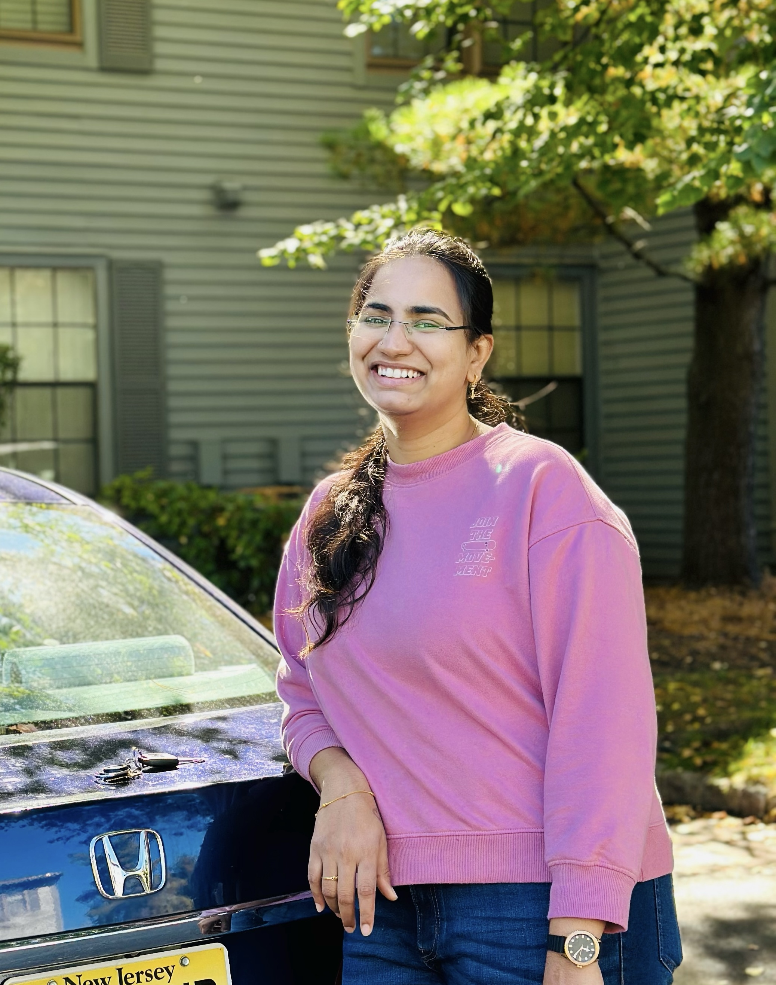
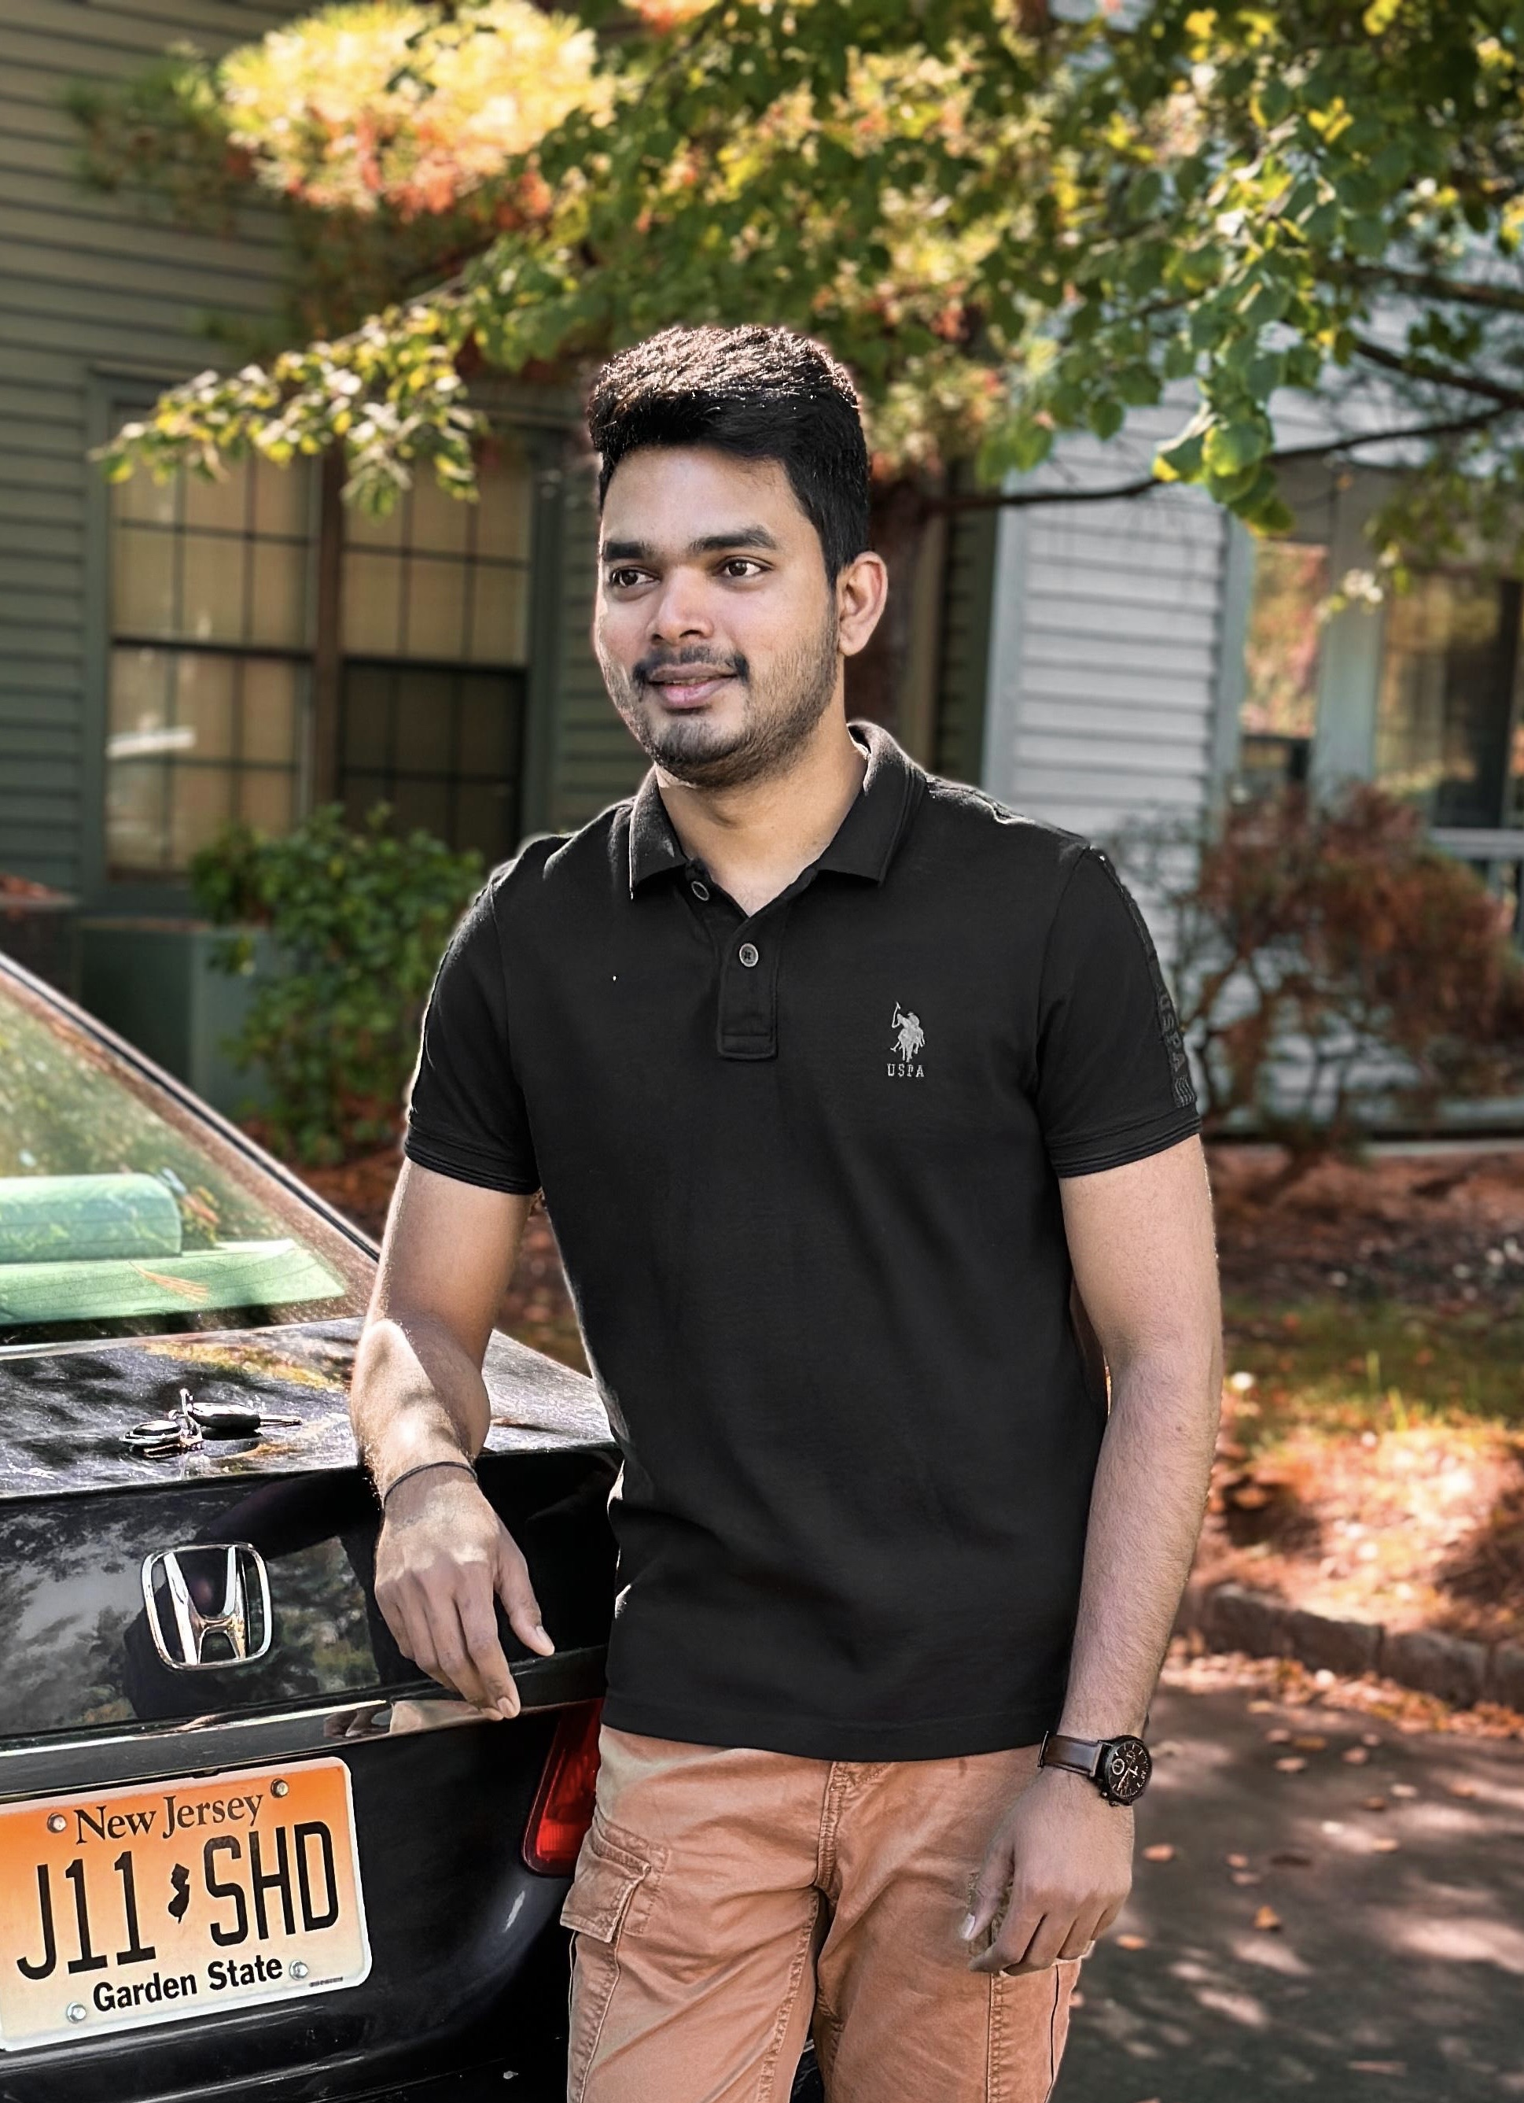
TEAM MEMBERS AND ROLES
Aishwarya More Software Developer & Business analyst (am99715n@pace.edu)
Naga Lavanya Mukku Backend Developer & Software test Engineer (nm26028n@pace.edu)
Shiva Krishna Maddela Software Developer & Devops Engineer (sm69485n@pace.edu)

Slide 7
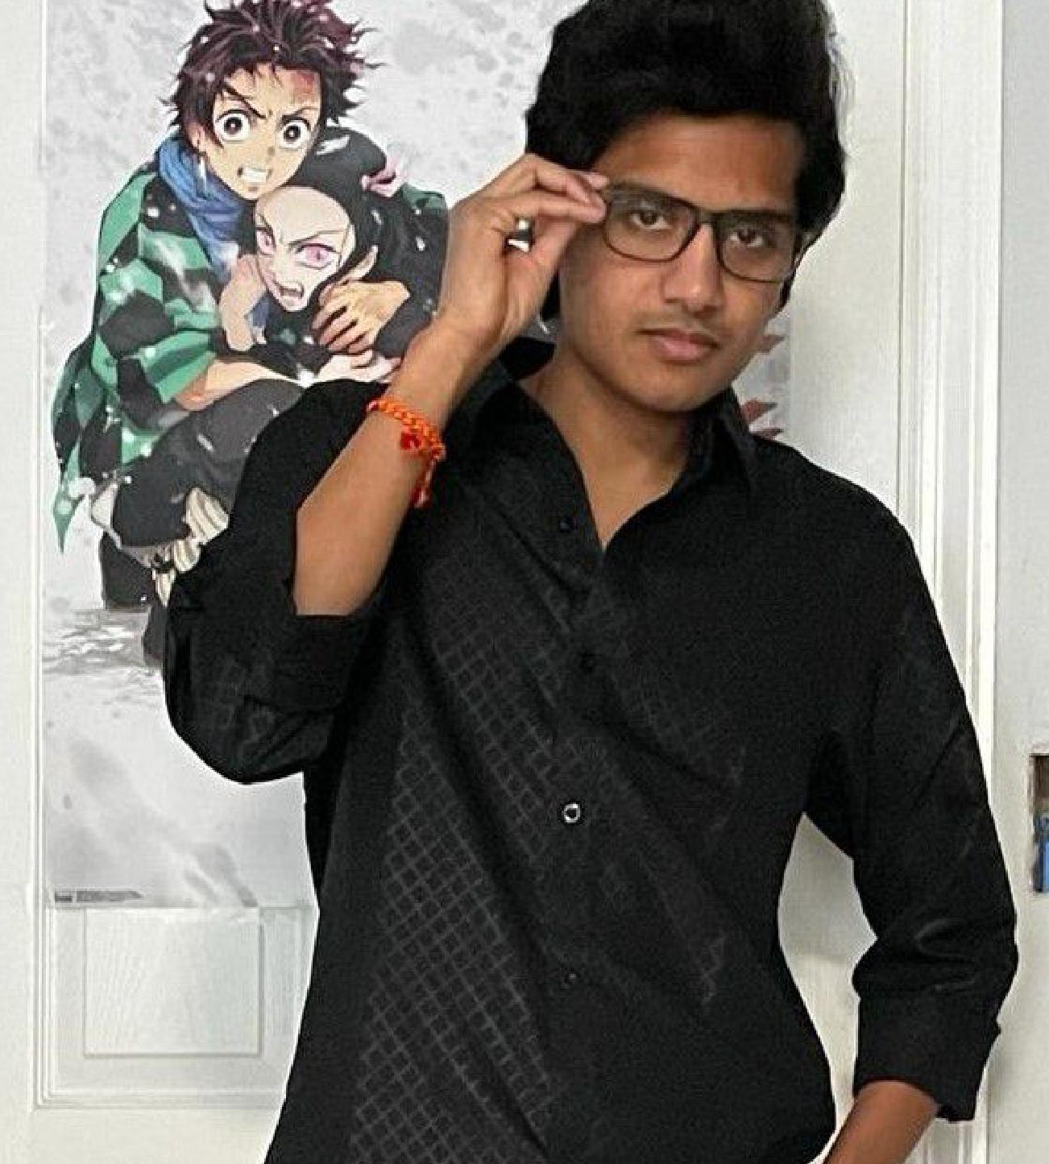

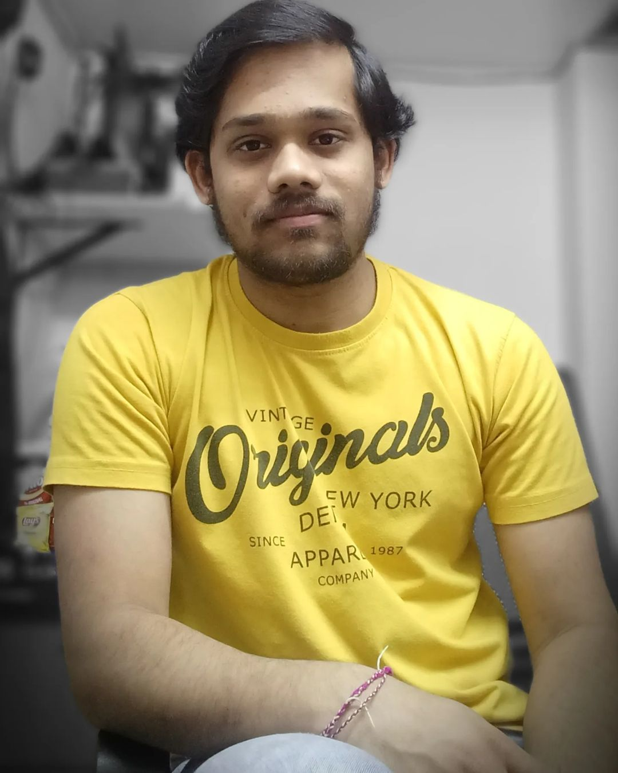
TEAM MEMBERS AND ROLES
Pushpak Kamisetti Software Developer & Machine Learning Engineer (pk39545n@pace.edu)
Afroze Fatima Software Developer (an75415n@pace.edu)
shashidhar pinumalla Front End Developer (sp16592n@pace.edu)

Slide 8
Personas

Slide 9
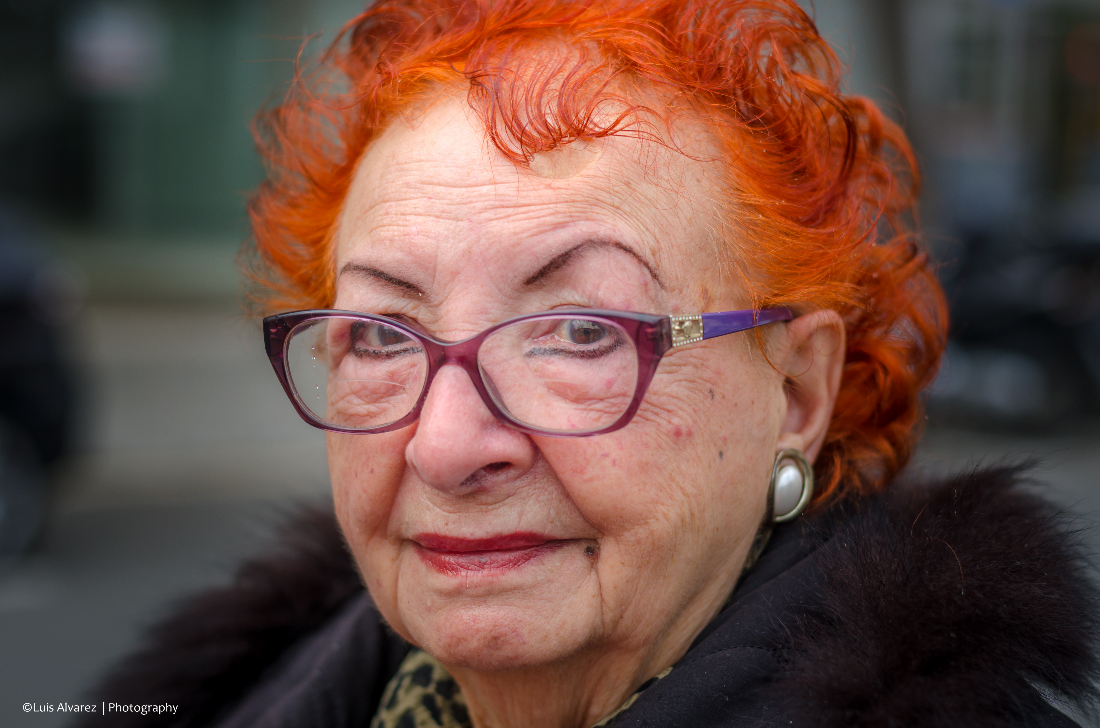
Persona: Sarah (Senior Citizen)
Age: 70
Sarah is a retired teacher who lives alone in a suburban area. Due to her age, she has multiple chronic conditions like diabetes and hypertension. Sarah needs an app that can help her manage her medications, track her vitals, schedule doctor appointments, and provide educational resources about her health conditions. She prefers simple interfaces and clear instructions due to her limited experience with technology.

Slide 10

Persona: Aisha(Software Developer)
Age: 28
Aisha, a busy tech professional and fitness enthusiast, struggles with anxiety due to work pressures. She needs OneCare to manage her mental well-being alongside her physical health. Features like meditation sessions, medication reminders, and access to mental health resources would help her prioritize self-care and overall well-being."

Slide 11

Persona: James(Sales Executive)
Age: 38
James leads a busy life with frequent travel and high-stress job. He often experiences minor health issues like headaches and fatigue but struggles to identify suitable treatments.James needs OneCare to quickly suggest medications based on his symptoms using predictive medicine feature. This saves time and helps him make informed health decisions without constant visits to the doctor.
This Photo by Unknown Author is licensed under CC BY-NC

Slide 12












Technologies

Slide 13


Team Working Agreement
Team working agreement

Slide 14

Project Schedule

Slide 15
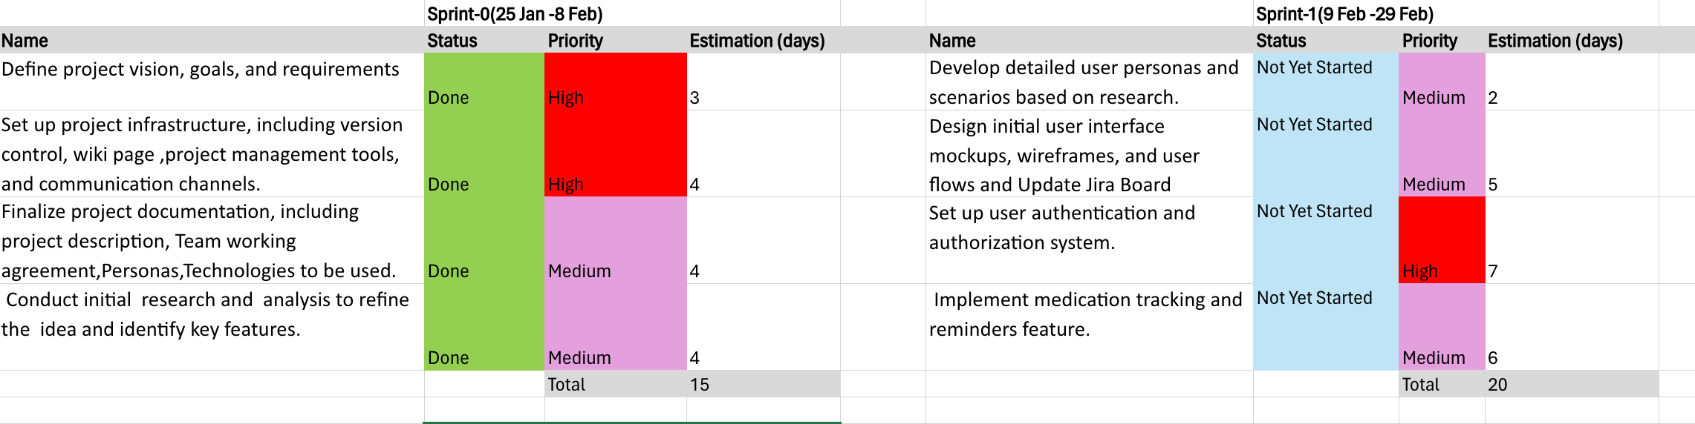
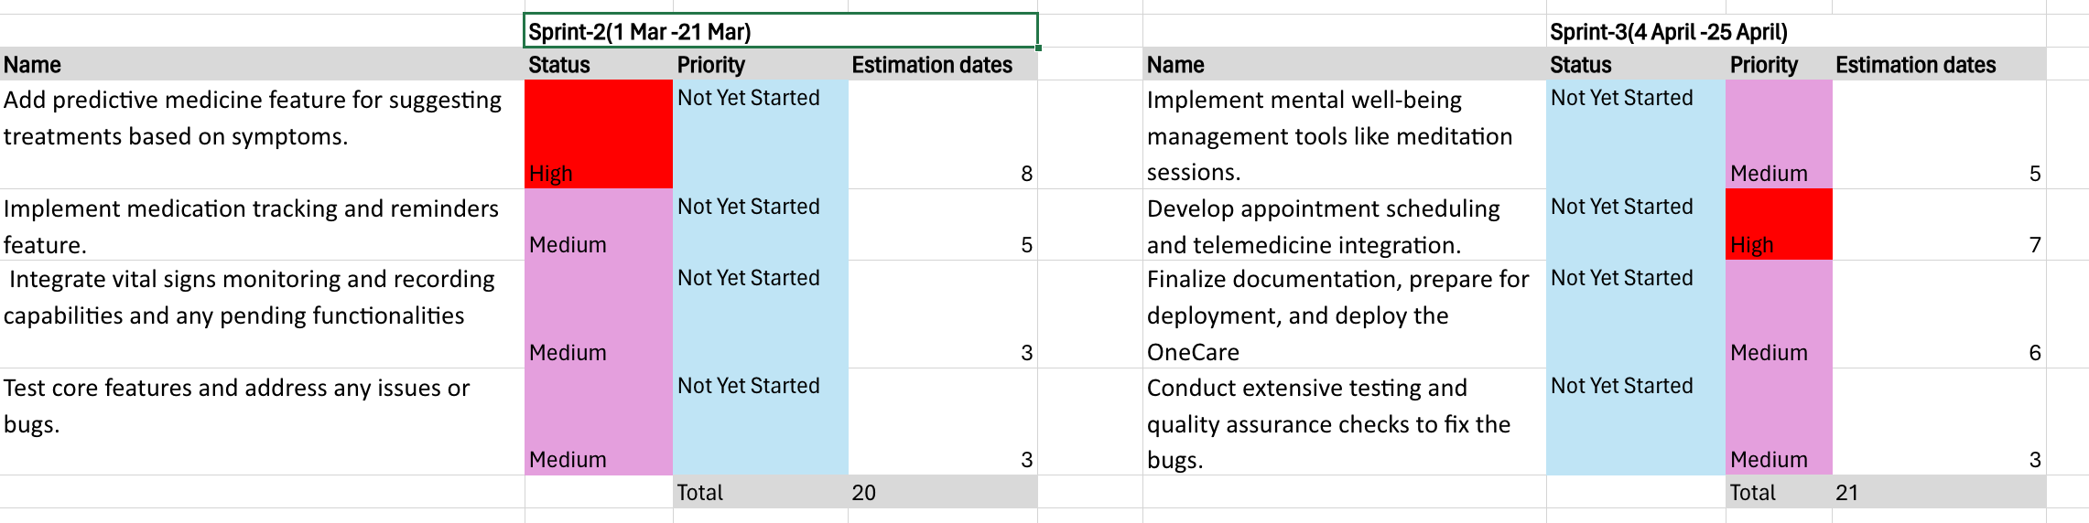
Project Schedule

Slide 16
RETROSPECTIVE

Slide 17

What worked well?
Completion of setup tasks (e.g., environment setup, tool configuration etc).
Initial planning and preparation for upcoming sprints.
Successfully completed Sprint 0 activities, including project setup and idea finalization.
Documented project requirements, user personas, and team working agreements.
Team Collaboration: Effective use of communication channels, fostering a collaborative environment.

Slide 18

What needs Improvement?
Need definition of project features to be implemented
Improve task distribution to ensure equal workload.
Jira Board: Need to expedite the setup of the Jira board for task tracking.

Slide 19

What’s next?
Schedule regular team meetings to improve communication.
Update JIRA board to improve task management.
Prioritize items for Sprint 1
Hold a team meeting to discuss implementation of features
Assign ownership to team members for action items identified during the retrospective to ensure accountability and follow-through.

Slide 20

WIKI PAGE LINK : https://github.com/more-aishwarya/OneCare/wiki

Slide 21

THANK YOU

